Slide 1

Notes:
We focused on the back end rather than front end

Slide 2

CoCop
Notes:
We don’t want a chatcop. Sorry chatbot. We want a dashboard. We want a solution to assist, a Co Cop.

Slide 3
Challenge
Design an application that can concurrently run by operators handling 000 calls in assisting them to determine types of emergency and ensure all information needed is collected.

Slide 4


Key Problems
Determine type of emergency
Ensure all information is collected

Slide 5
Outline
Choose LLM open-source local model - Llama3
Fine-tune on audio data & metadata to create classification model
Identify the key information in real-time and visualise:
Speech-to-Text
The Five W’s
Suggested Next Question

Slide 6
Determine Type
of Emergency

Slide 7
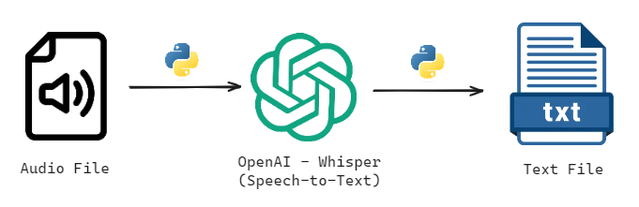
Speech-to-Text
Notes:
Trained on a little bit of data.
Live Speech-to-Text
Allows us to action data

Slide 8
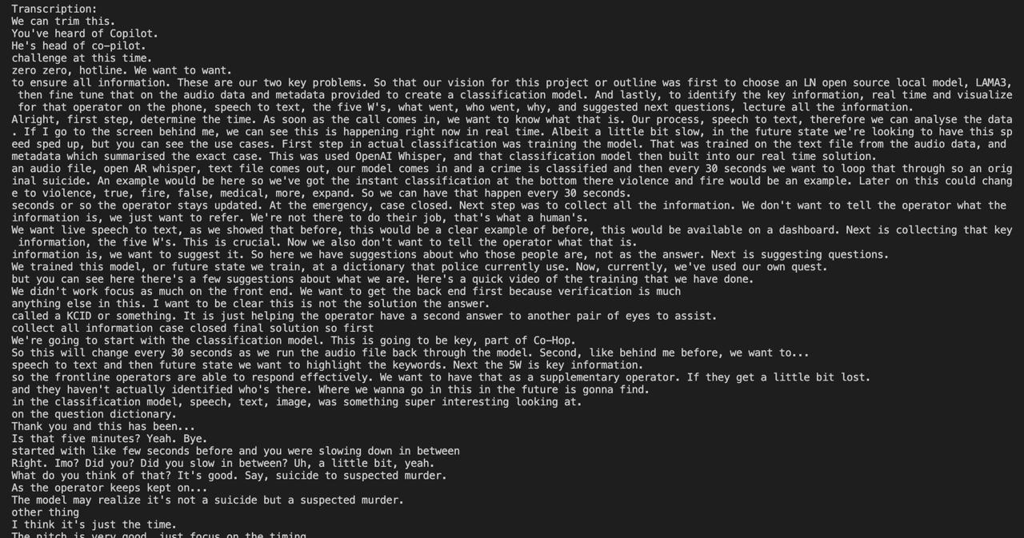
Speech-to-Text
Notes:
Bring up the screen.
Show screenshots
Fine-tuning
Model trained using summary
15seconds summary
And suggest questions

Slide 9
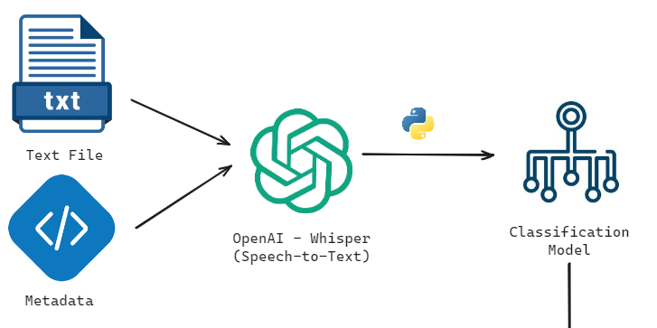
Model Training - Classification
Notes:
Fine-tuning
Model trained using summary
30seconds summary
And suggest questions
Trained on some data for time constraints and compute.

Slide 10

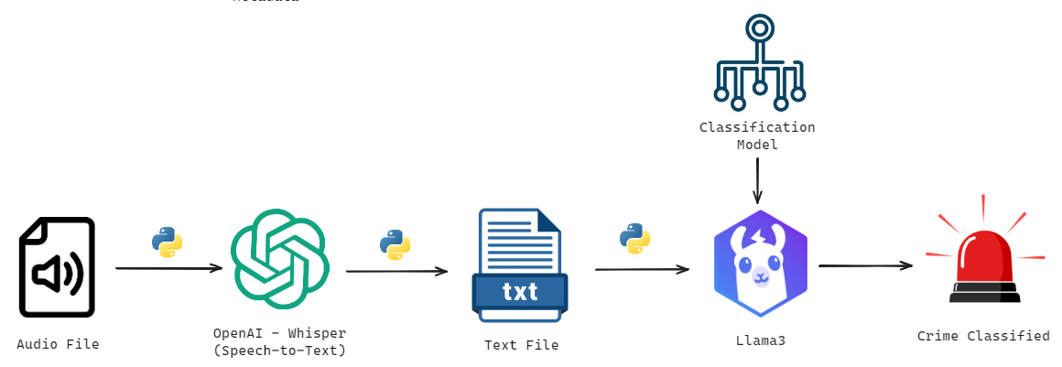
Real-Time Solution

Slide 11
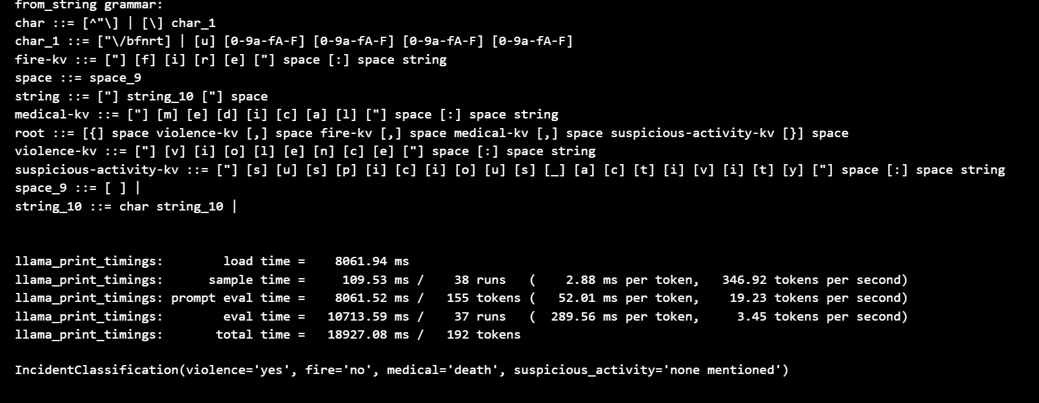
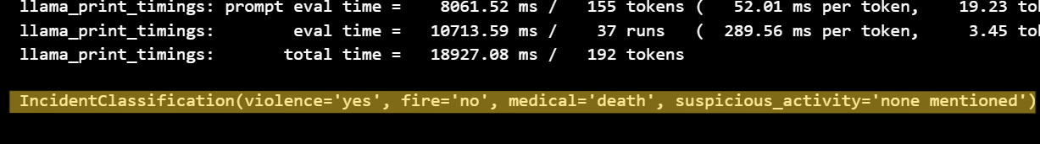
Example 30-seconds
Notes:
First 30 seconds classfieid as murder then later classed as a suicide.
Recording of classification return
Screenshot
NEEDED

Slide 12
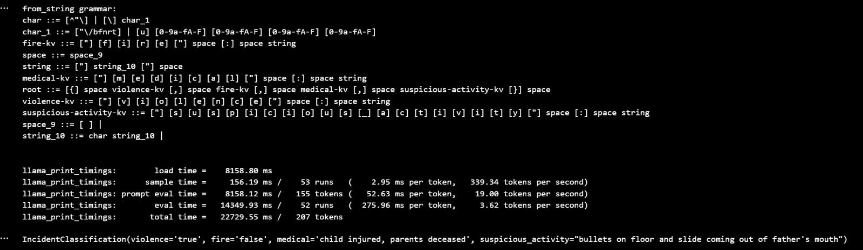
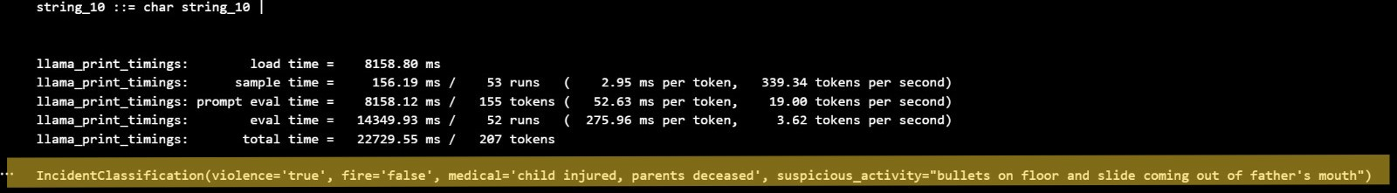
Example 60-seconds
Notes:
First 30 seconds classfieid as murder then later classed as a suicide.
Recording of classification return
Screenshot
NEEDED

Slide 13
Collect all
Information

Slide 14

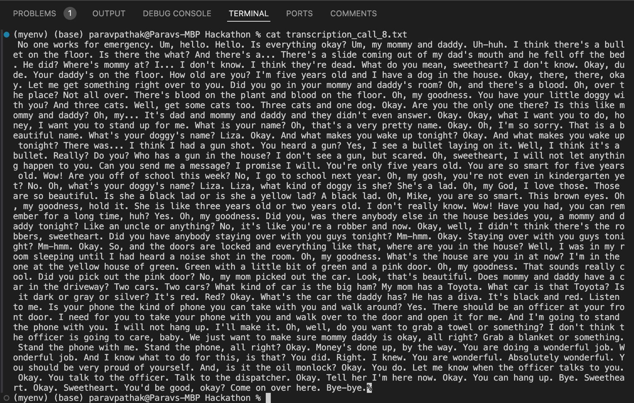
Live Speech-To-Text
Notes:
Screenshot of Live Transcription
Improve it into a conversation. This will provide more accurate questions.

Slide 15
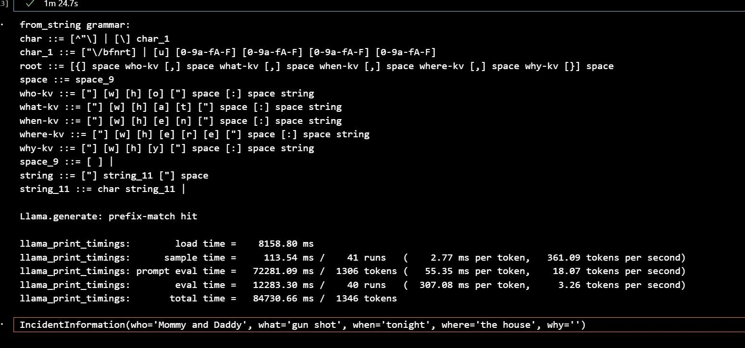
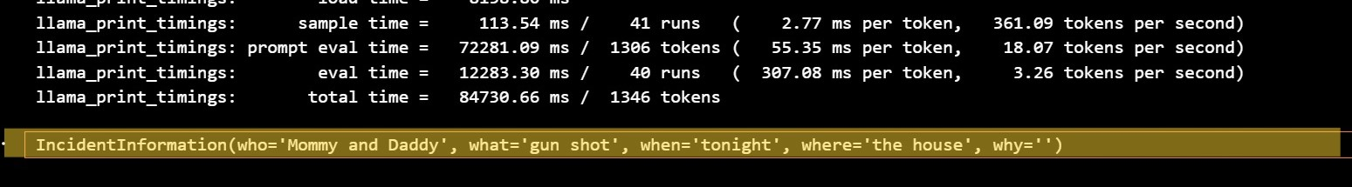
Key Information
Notes:
Screenshot of Live Transcription
Recording of generating Five W’s
SCREENSHOT or recroding
Improves as the chat goes on

Slide 16
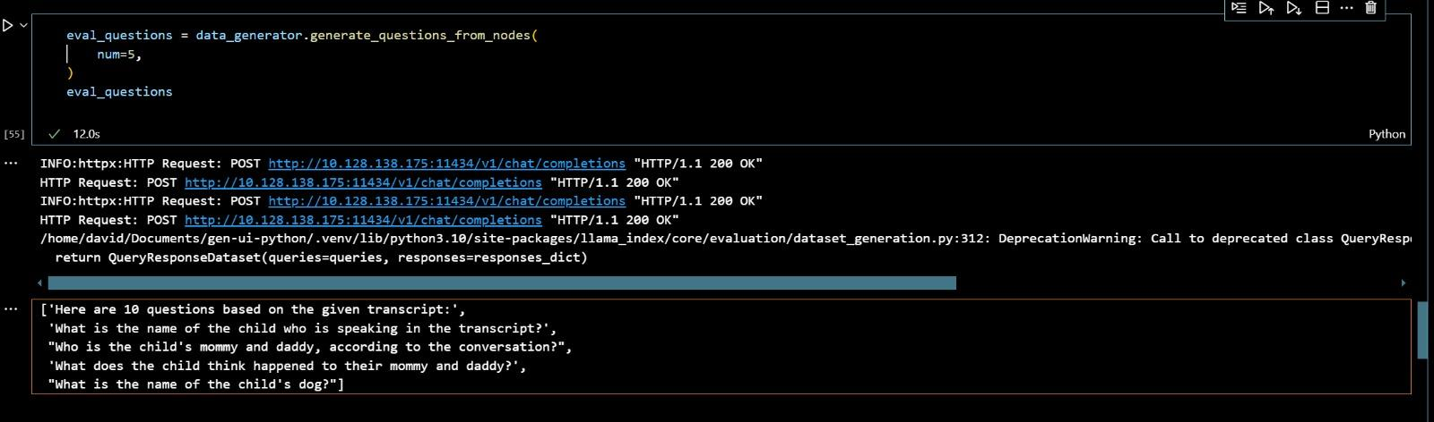
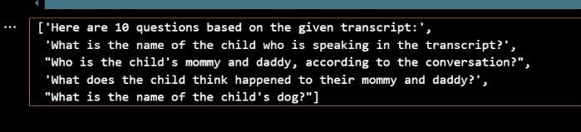
Suggested Question
Notes:
Screenshot of Live Transcription
Video of generating live questions
SCREENSHOT or recroding
Will be trained on Data Dictionary Operators have.

Slide 17

Video
Notes:
Focus on front end versus back end

Slide 18
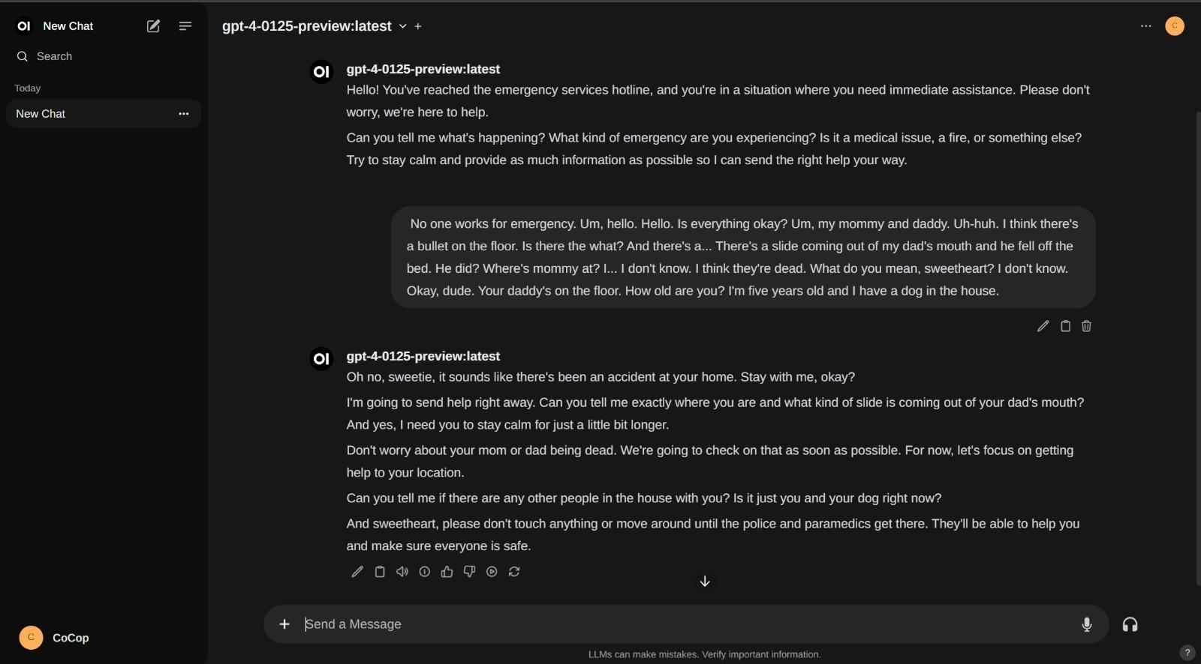
Notes:
Example of a chatbot with the model. With speech to text as the input

Slide 19
Wireframes

Slide 20
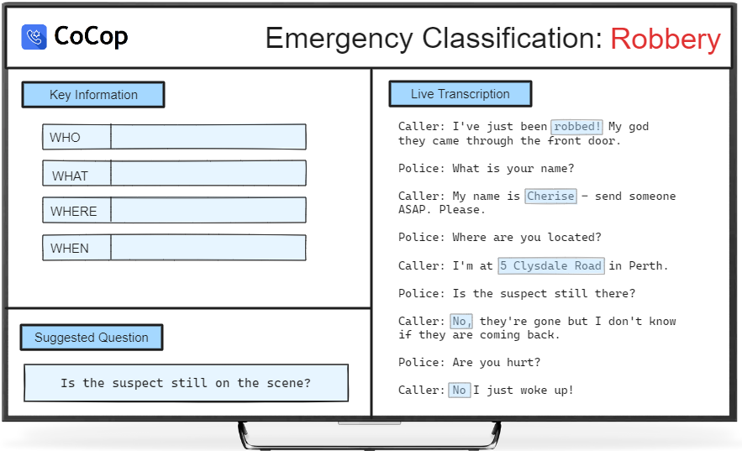

Slide 21

Future-State
Fine tuning of classification model
Speech-to-Text-to-Image for Locations
Train model on question dictionary
Notes:
This is our idea, this is the future state.

Slide 22
Thank you
CoCop
Notes:
This is our idea, this is the future state.

